Slide 1


Group Members Amna Naeem Muneeba Sohail Romeesa Khalid Sabila Ali Wajiha Ismail
JINNAH UNIVERSITY FOR WOMEN
Department of Commerce
Introduction to Money and Banking

Slide 2
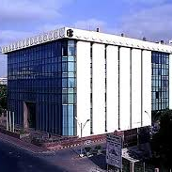
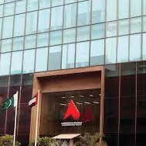
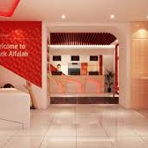
INTRODUCTION:
It was incorporated as public limited company on June 21-1992 under the companies’ ordinances 1984.
Banking operations commenced from November 1, 1997.
Bank is owned and operated by Abu Dhabi Group.
The sixth largest bank in Pakistan.

Slide 3
SOME CORE INFORMATION ABOUT BANK ALFALAH
Type | Private
Traded as | PSX:BAFL
Founded | June 21, 1997(22 years ago)
Headquarters | Karachi, Pakistan
Key people | H.H. Sheikh Hamdan Bin Mubarak Al Nahayan(Chairman) H.H. Sheikh Mansour Bin Zayed Al Nahayan(Owner) Javed Khalid(Owner)
Products | Loans, Credit cards, Savings, Consumer banking
Revenue | Rs:55.378 billion(US$390 million)(2014)
Net Income | Rs:8.513 billion(US$60 million)(2014)
Owner | Abu Dhabi group 58% and United venture holding 42%
No. of employees | 7000+(2018)
Website | www.bankalfalah.com

Slide 4
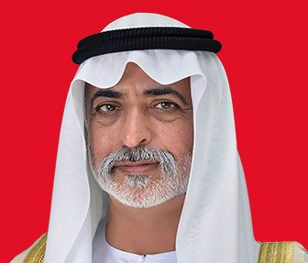
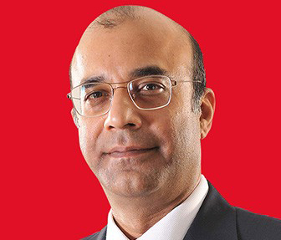
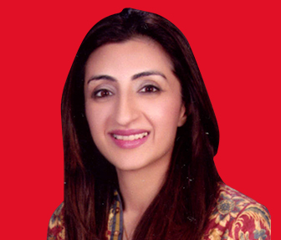
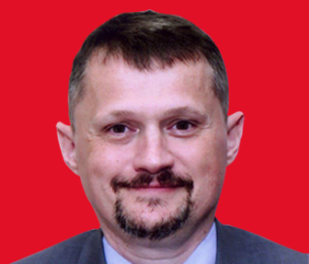
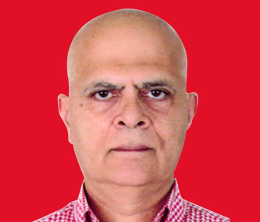
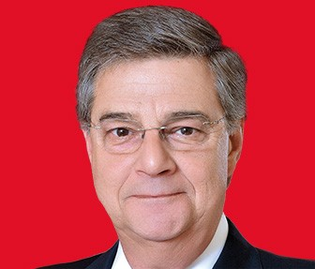
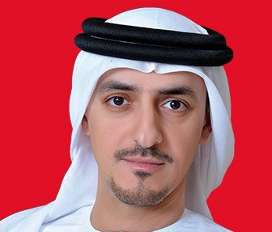
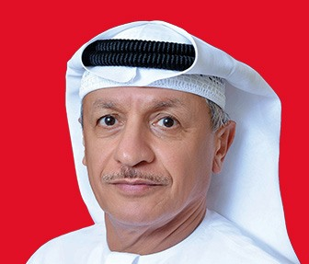
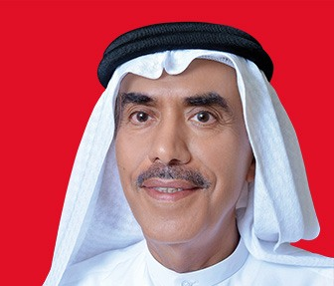
B0ARD OF DIRECTORS & CHAIRMAN:
Sheikh Nahyan bin Mubarak Al Nahyan(Chairman)
Mr. Nauman Ansari (Director & CEO)
Dr. Ayesha Khan (Director)
Dr. Gyorgy Tamas Ladics (Director)
Mr. Shahzad Naqvi (Director)
Mr. Efstratios Georgios Arapoglou (Director)
Mr. Khalid Mana Saeed Al Obaita (Director)
Mr. Abdulla Khalil Al Mutawa (Director)
Mr. Abdulla Nasser Hawaileel Al Mansoori (Director)

Slide 5



FINANCIAL SOLUTIONS:
The Bank provides financial solutions to consumers, corporations, institutions and governments through a broad spectrum of products and services including corporate and investment banking, consumer banking and credit, securities brokerage, commercial, SME, agri-finance, Islamic and asset financing.

Slide 6


RE-BRANDING:
The bank has entered re-branding as of February 2015 after 17 years of its birth. The official colour has been changed from Deep Blue to Crimson red and the logo has been also changed. The new logo has been named as well, Chevron. Meanwhile, the vision & mission statements have also been revised.

Slide 7



MISSION
We look at the market with fresh eyes to find new opportunities and seek new ways of enabling our customers to succeed and advance the world of finance.
VISION
To inspire and empower people to do things differently and shape their own path in life and business.

Slide 8
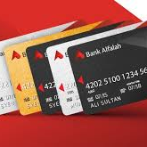
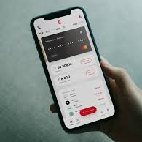
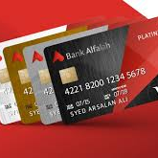


BANK ALFALAH SERVICES:
Online Banking
Alfa (mobile app)
SMS Alert
E-Statement
Credit Cards
Bank Alfalah Titanium Credit Card
Bank Alfalah Visa Gold Card
Bank Alfalah Visa Platinum Credit Card
Bank Alfalah Visa Silver Credit Card
Bank Alfalah Ultra Credit Card
Debit Cards
Alfalah PayPak Classic Debit Card
Alfalah Visa Classic Debit Card
Alfalah Visa Gold Debit Card
Alfalah Visa Platinum Debit Card
Alfalah Visa Signature Debit Card

Slide 9
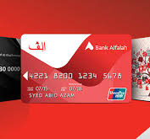

TYPES OF ACCOUNT:
Alfalah Current Account
Alfalah Saving Account
Alfalah Basic banking Account
Alfalah Term deposit Account

Slide 10
ALFALAH CURRENT ACCOUNT:
Alfalah Asaan Remittance
Alfalah Kamyab Karobar
Alfalah PKP Current Account
Alfalah FCY Current Account
ALFALAH SAVING ACCOUNT:
Alfalah Kifayat Monthly Saving Account
Alfalah Care Senior Citizen Saving Account
Alfalah Royal Profit
Alfalah Asaan Saving Account
ALFALAH FIXED DEPOSIT ACCOUNT:
Alfalah Floating Term Deposit
Alfalah Mahan Adman Term Deposit
Alfalah Foreign Currency
ALFALAH BASIC BANKING ACCOUNT:
Initial Deposit Account Opening Is Rs:1000
No Minimum Balance Requirement
Non Interest Bearing
Maximum 2 Deposit and 2 withdraw through Cheque is allowed

Slide 11
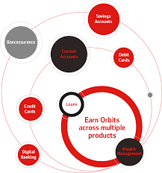
ALFALAH ORBIT REWARDS:
Introducing the first of its kind loyalty program in Pakistan that rewards you on your entire banking system.
HOW TO EARN ORBITS?
Enter in orbits and earn orbits(points) on:
Debit cards
Credit cards
Loans
Investment products
Bancassurance
Sms alerts
E-statement
Transaction transfer
Atm
Internet banking

Slide 12
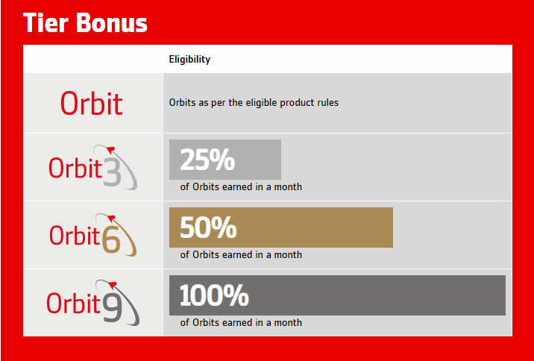
ALFALAH ORBIT TIERS:
Alfalah Orbit Rewards has four different tiers. To upgrade your tier you can sign up for more products or services and earn accelerated Orbits.

Slide 13
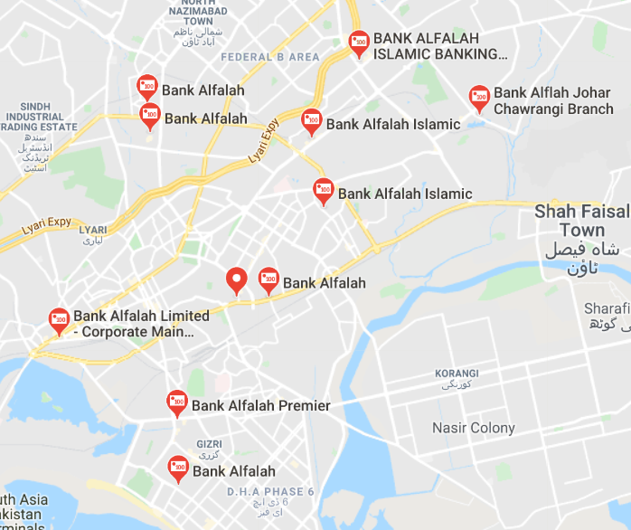
BRANCHES OF BANK:
The Bank does business through a network of over 500 branches in more than 170 cities in Pakistan.
Bank has international presences in Afghanistan, Bangladesh, and Bahrain.
A representative office in the UAE.

Slide 14
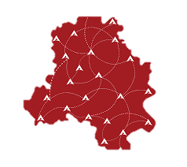
Thank You
GROUP OF BANK ALFALAH

